Slide 1
Circles

Slide 2
Parts of a Circle
Centre

Slide 3
Parts of a Circle
Diameter (must go through the centre)

Slide 4
Parts of a Circle
Radius (half a diameter – from the outside to the centre)

Slide 5
Parts of a Circle
Sector (like a slice of pizza)

Slide 6
Parts of a Circle
Chord (a line that crosses the circle but not through the centre)

Slide 7
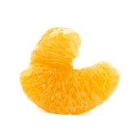
Parts of a Circle
Segment (looks a bit like an orange segment)

Slide 8
Parts of a Circle
Circumference (the perimeter of the circle)

Slide 9
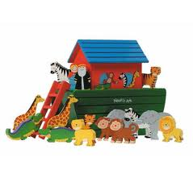
Parts of a Circle
Arc (part of the circumference)

Slide 10
Parts of a Circle
Tangent (a line that touches the circle at a single point on the circumference

Slide 11
Parts of a Circle
Semicircle (half a circle)

Slide 12
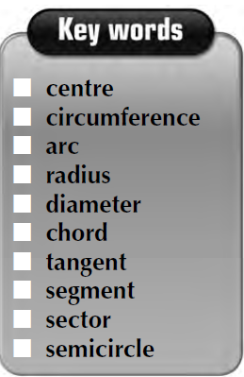
What is this?
Radius

Slide 13
What is this?
Semicircle

Slide 14
What is this?
Centre

Slide 15
What is this?
Diameter

Slide 16
What is this?
Chord

Slide 17
What is this?
Sector

Slide 18
What is this?
Circumference

Slide 19
What is this?
Segment

Slide 20
What is this?
Tangent

Slide 21
What is this?
Diameter

Slide 22
What is this?
Sector

Slide 23
What is this?
Semicircle

Slide 24
What is this?
Segment

Slide 25
What is this?
Chord

Slide 26
What is this?
Tangent

Slide 27
What is this?
Arc

Slide 28
Homework: Learn these words (meanings & spellings)

